Slide 1

Internet of Things Pet Feeder Project
Masters degree in Computer Engineering
2022/2023

Slide 2
Summary
Introduction
Related works
System Architecture
Interoperability

Slide 3
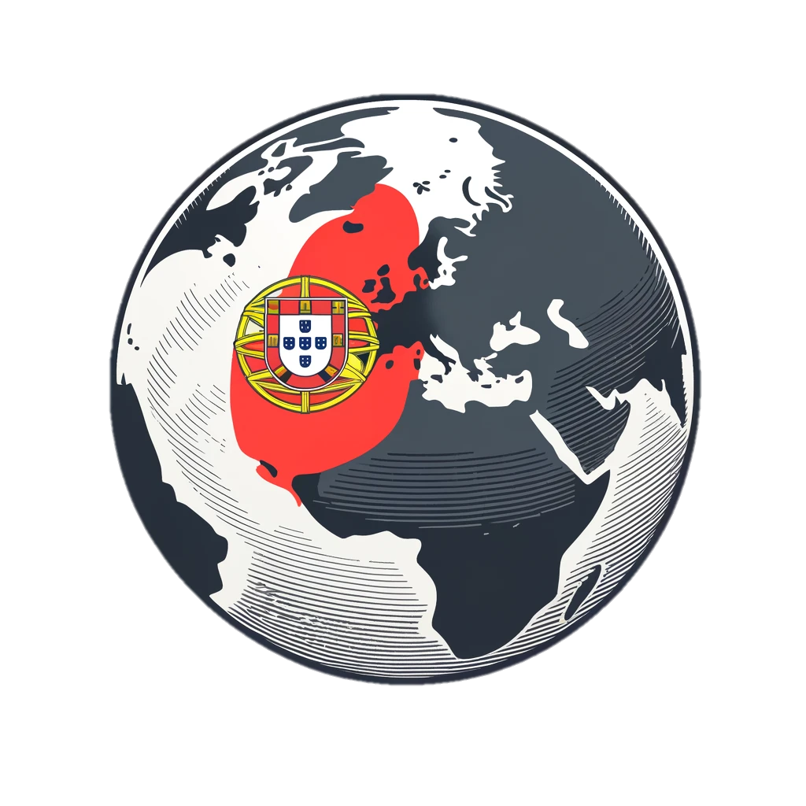
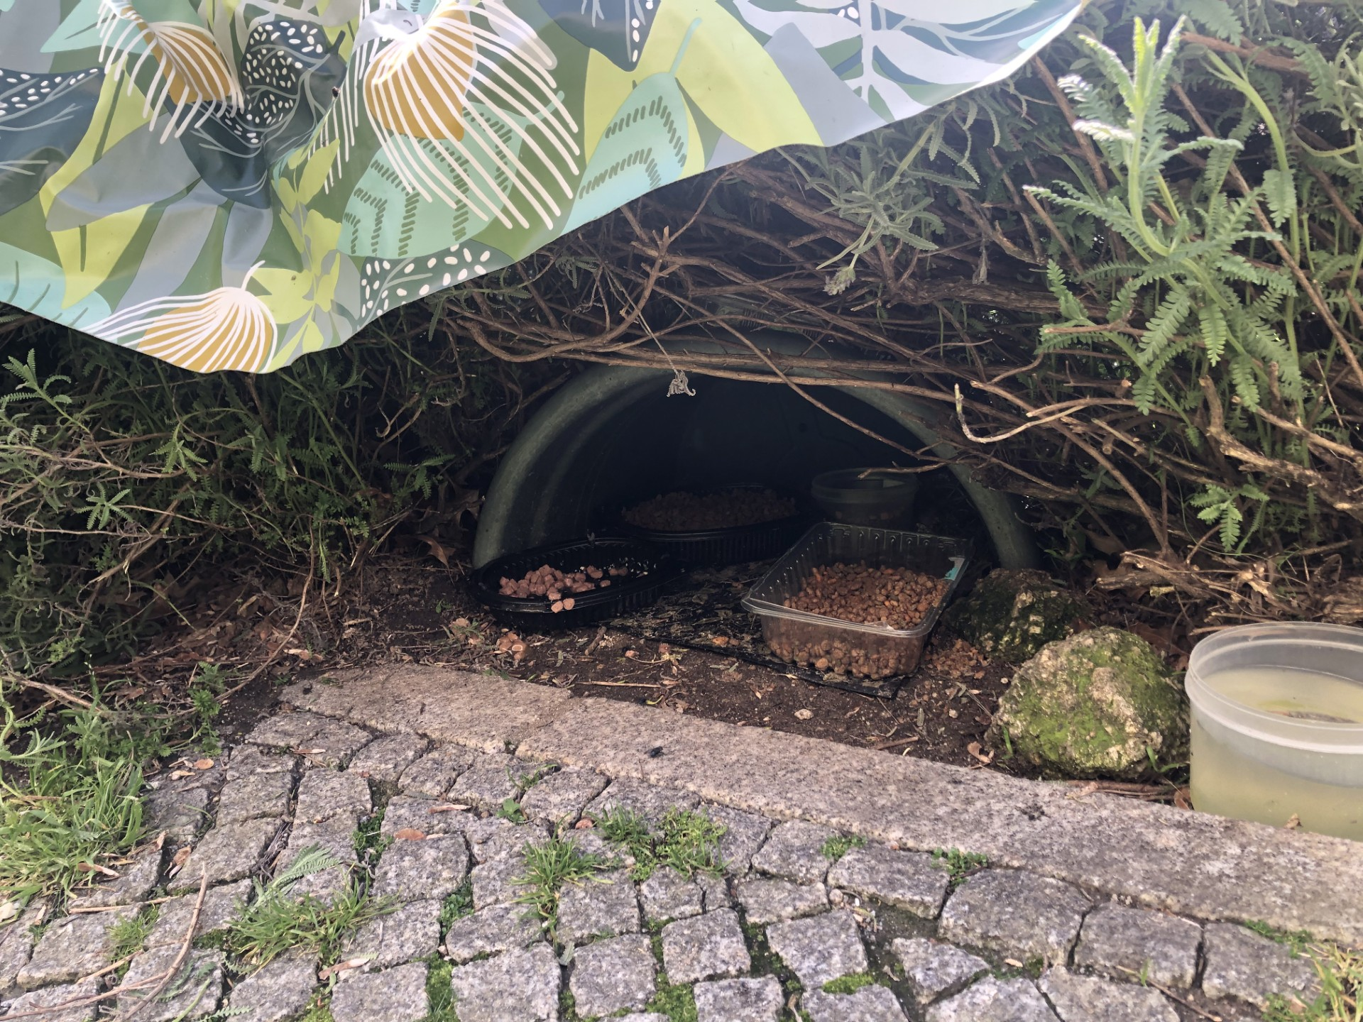
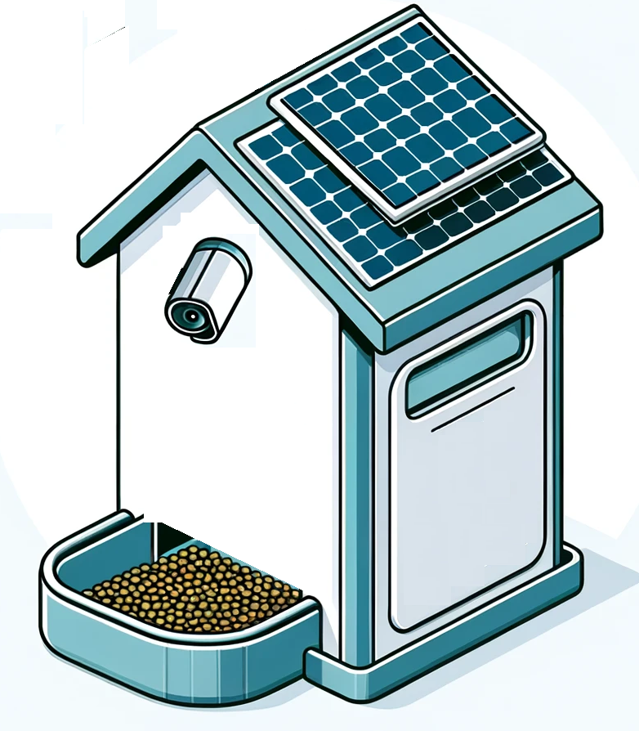
Introduction
Globally, 1 in 3 pets is homeless (Mars Project)
The 2016 cat population in Portugal was estimated at 991,000 (D’Avila)
This project seeks to establish secure feeding boxes for the area's stray cats, ensuring they have consistent access to nutritious food in a safe environment, therefore enhancing their well-being.
991,000 cat population
Avenida do Biribau, Covilhã
Near UBI
Feeding Box Project

Slide 4
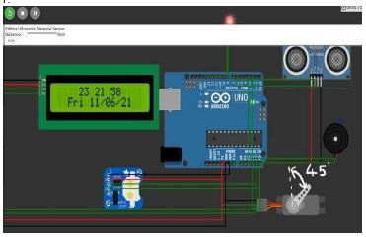
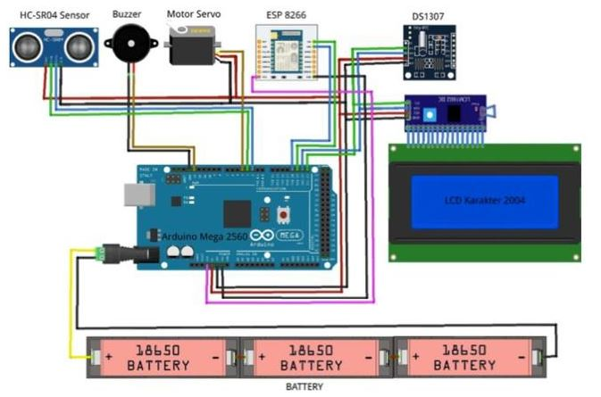
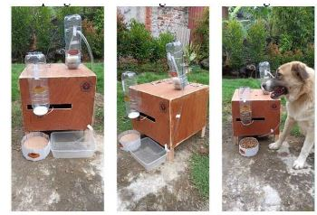
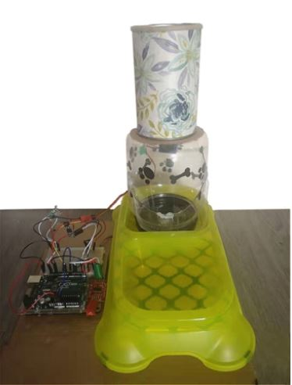
Related works
Component | 1st Solution | 2nd Solution | 3rd Solution | 4th Solution | 5th Solution
Function | Remote Monitoring and Feeding | Monitoring and feed scheduling | Remote Monitoring and Feeding | Feeding and drinking management | Remote Monitoring Feeding, drinking and litter box
Microcontroller | Arduino Uno | Arduino Uno | Arduino Uno | Arduino Uno | Arduino Uno
Communication | ESP8266 WiFi | ESP8266 WiFi | ESP8266 WiFi | ESP8266-01 | ESP8266 WiFi
Sensors | Real Time Clock, Load Cell, Servo Motor, TCS3200-color Sens., Camera | Real Time Clock, Load Cell, Servo Motor, Ultrasonic | Real Time Clock, Load Cell, Servo Motor, Ultrasonic | Real Time Clock, Load Cell, Servo Motor, Ultrasonic | Infrared Sensor(PIR) Load Cell, Servo Motor
Interface | Telegram App | Blynk App | Blynk App | Blynk App | Blynk App
First
Second
Third
Fourth
Fifth

Slide 5
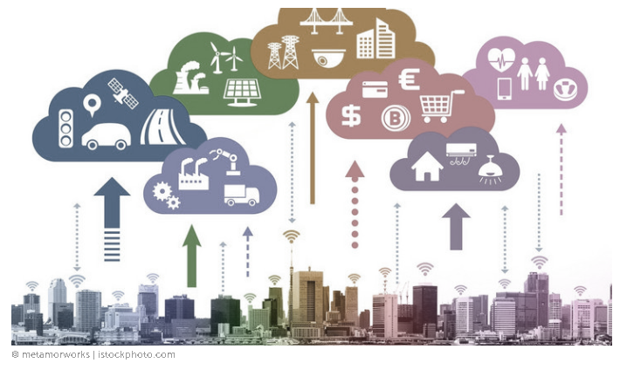
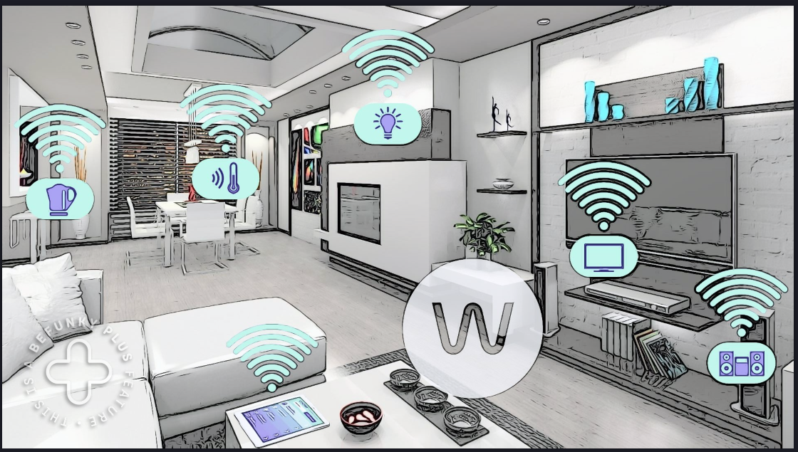

Related works
 | Smart Cities | Smart Homes
Focus | Enhance urban life on a large scale; address infrastructure, energy, transportation, healthcare, and services | Focus on individual residences; enhance convenience, security, and energy efficiency
Challenges | Manage and protect vast amounts of data, integrate diverse systems, ensure security and scale solutions | Ensure user privacy, integrate devices user-friendly, and maintain reliable connectivity
Impact | Affect entire communities and urban systems | Just individual living spaces
Smart Cities
Smart Homes

Slide 6
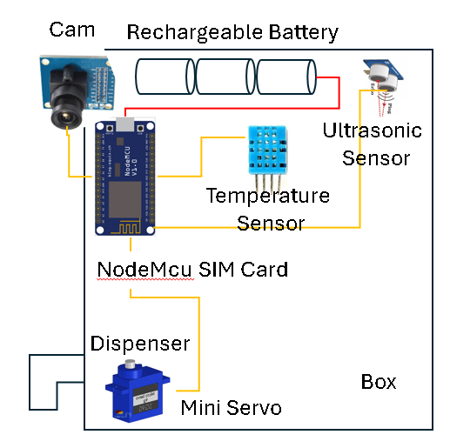
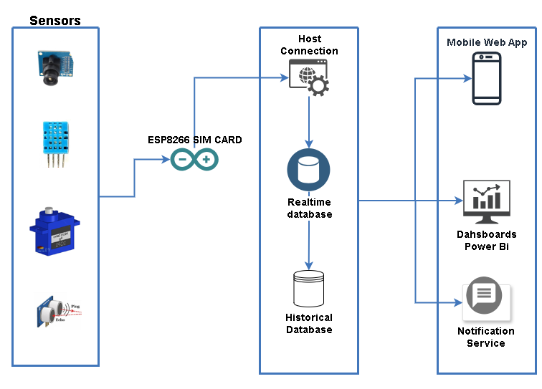
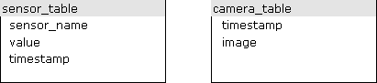
System Architecture
Itens:
– Solar Cells
– NodeMcu Sim Card
– Rechargeable Battery
– Temperature and Humidity Sensor
– Mini servo motor
– Ultrasonic Sensor
– Camera
Server:
Net Core 8.0, Json, SQL Azure, Azure App Service, Python
App:
React Native
Node
Database:
SQL Azure
Postgres
Box components
Architecture Design
Database

Slide 7
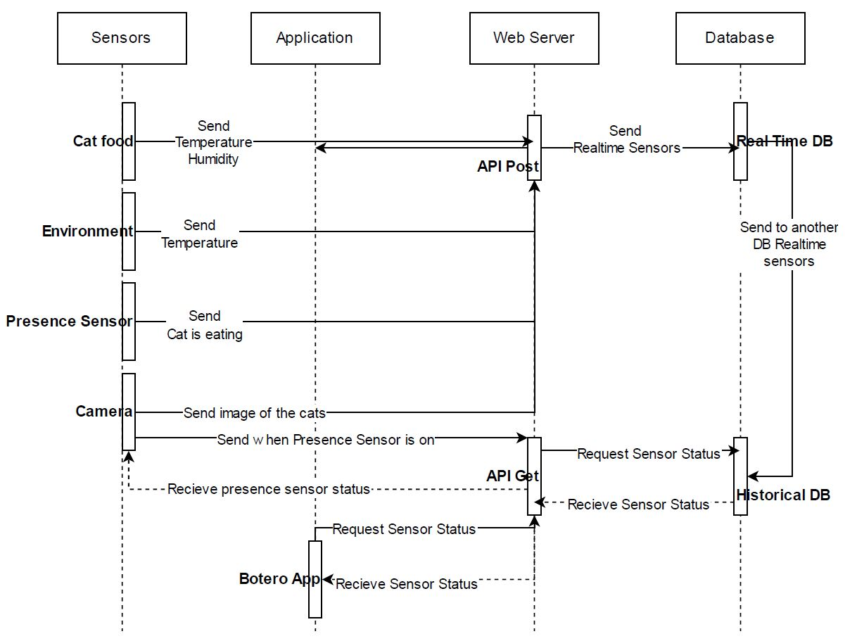
System Architecture

Slide 8
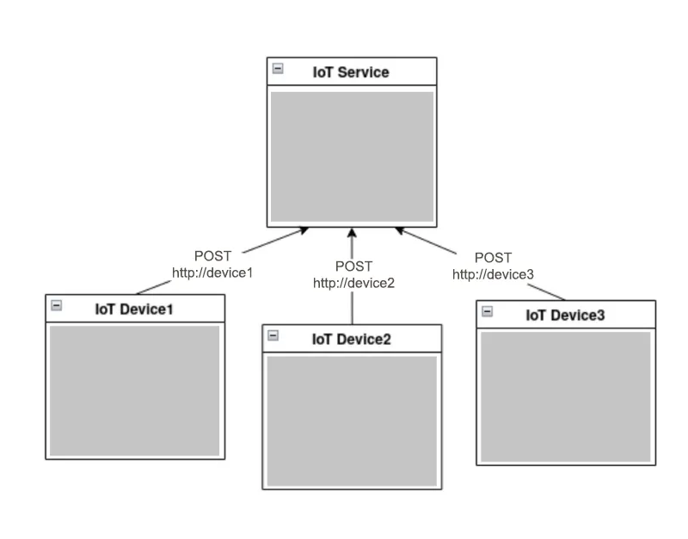
Interoperability
The adoption of open standards is one way to ensure this interoperability, along with the use of application programming interfaces (APIs).

Slide 9
Thanks a million
https://github.com/juscelior
https://github.com/renejerez
2022/2023

